Slide 1

STARBUCKS: A Health check
AMIT KUKREJA
27-JUNE-2022

Slide 2
I love my daily starbucks shot, but…
Is my Starbucks drink healthy ?
Is it OK to have it everyday ?
Just how much Starbucks is too much ?

Slide 3
To answer such questions we did a deep dive
Looked at the nutritional information provided by Starbucks
Across 220 different drinks – Espressos, Mochas, Lattes, Tazos and more
Based our analysis on USFDA guidelines

Slide 4
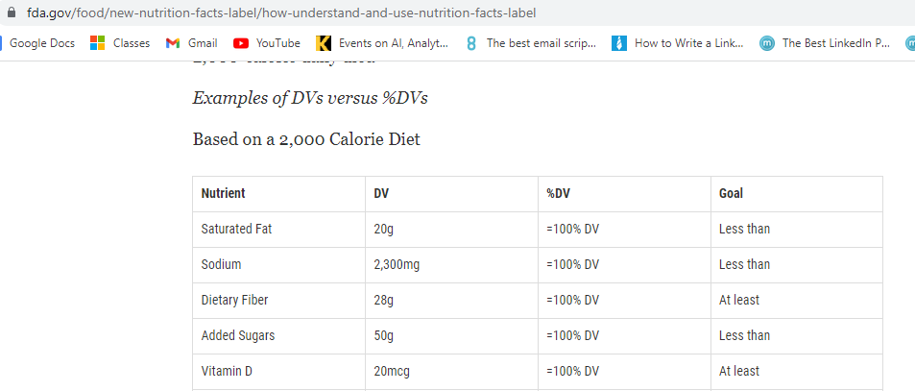
How did we do it ?
USFDA gives guidelines on Daily Values of nutrients
E.g. How much ‘caffeine’ or ‘added’ sugar is OK on a daily basis

Slide 5
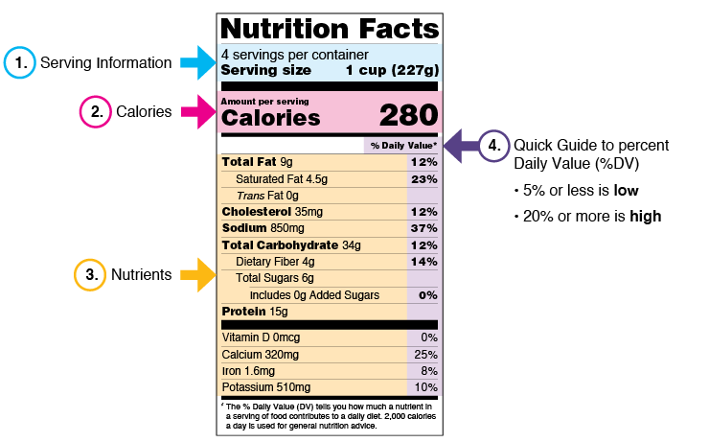
% DV (daily value): what % of a nutrient per serving is ok

Slide 6
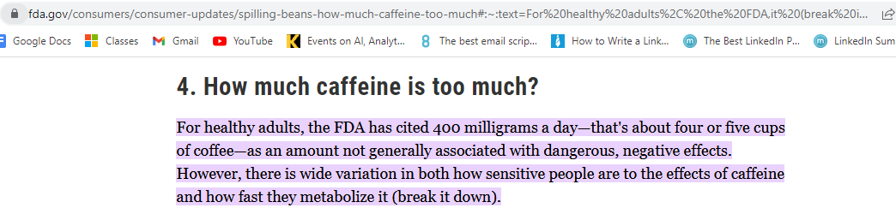
What does fda say about For caffeine:
So 80 – 100 MG OF CAFFEINE PER SERVING IS JUST FINE..

Slide 7
We looked at five elements
Total Calories
Total Fat
Caffeine
Added Sugars (sugar added over and above natural sugar in ingredients)
Cholesterol
And created a star rating for each drink

Slide 8
So a drinks gets
ELEMENT | 5-STARS | 4-STARS | 4-STARS | 0-STAR
Total Calories Total Fat Added Sugars Cholesterol | All 4 elements Below 10% Daily Value AND | Any one element above 10%, but Below 20% DV Other 3 are Below 10% DV AND | All 4 elements Below 10% Daily Value AND | Any element Above 20% Daily Value OR
Caffeine | Below 100mg (25% of DV) | Below 100mg (25% of DV) | Below 200mg (50% of DV) | Above 200mg (50% of DV)

Slide 9
AND THE RESULTS ARE …..

Slide 10
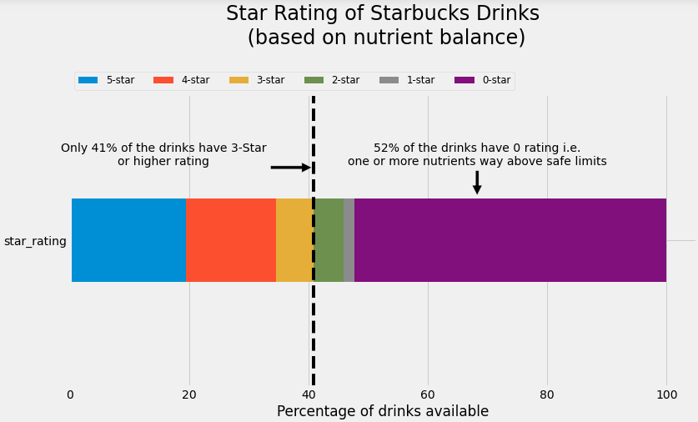

Slide 11
IS MY FAVOURITE DRINK SAFE ?? !!

Slide 12
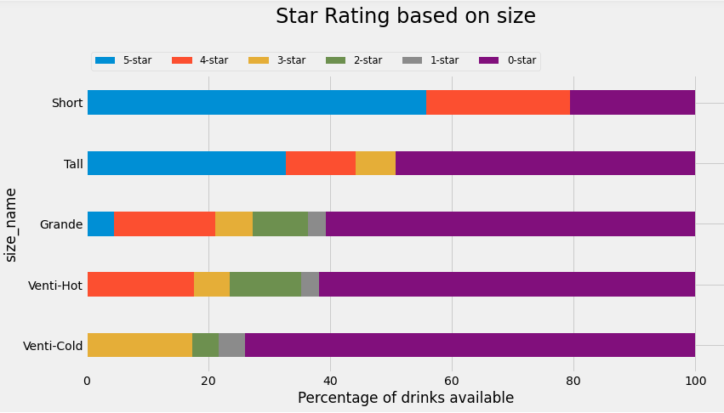
Check the size…it MATTERS a LOT !
80% of Shorts are fine, but more than 60% of Venti’s are NOT !!
Safe* Options / Total Options
27 / 34
31 / 61
18 / 66
8 / 34
4 / 23
*Options with > = 3-stars

Slide 13
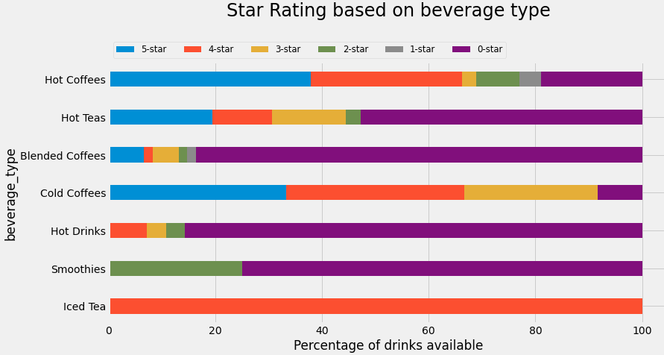
type of drink MATTERS TOO!
70% of Hot Coffees are fine, but more than 80% of Blended Coffees are NOT !!
Safe* Options / Total Options
51 / 74
16 / 36
8 / 61
11 / 12
3 / 28
0 / 8
1 / 1
*Options with > = 3-stars

Slide 14
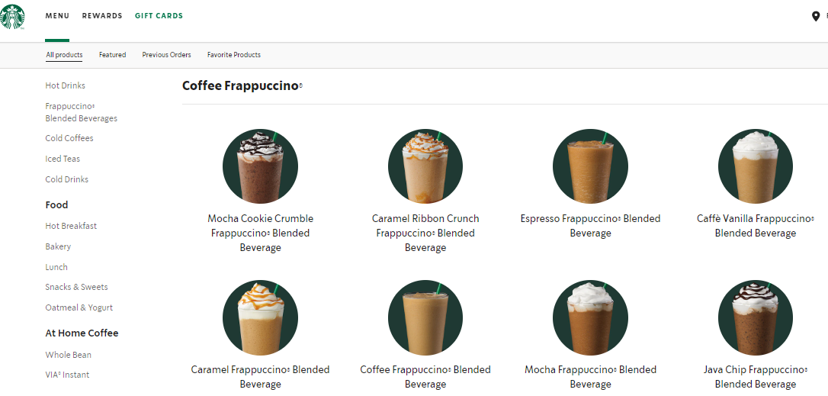
wondering what are blended coffees / hot drinks ?
Check out the starbucks website >>

Slide 15
SO WHICH NUTRIENT(S) ARE ABOVE SAFE LIMITS?

Slide 16
ENTER GREEN-AMBER-RED RATING FOR NUTRIENTS
ELEMENT | GREEN RATING | AMBER RATING | RED RATING
Total Calories Total Fat Added Sugars Cholesterol | Below 10% Daily Value | Above 10%, but Below 20% DV | Above 20% Daily Value
Caffeine | Below 100mg (25% of DV) | Above 100mg, but Below 200mg (50% of DV) | Above 200mg (50% of DV)

Slide 17
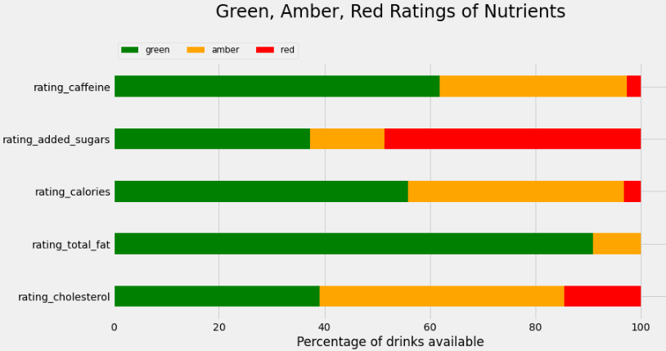
ADDED SUGARS ARE THE MAIN CULPRIT
49% drinks have high Added Sugars, Caffeine is within limits in 97% of drinks
Safe* Options / Total Options
214 / 220
113 / 220
213 / 220
220 / 220
188 / 220
*Options with > = 3-stars

Slide 18
To KNOW MORE ABOUT YOUR FAVOURITE DRINK logon ismycoffeesafe.com

